Slide 1

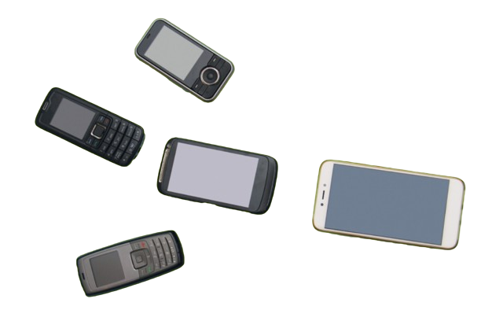
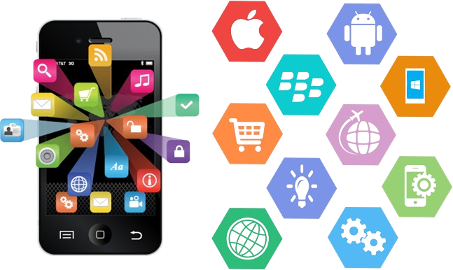
History Of Mobile & Mobile Application

Slide 2
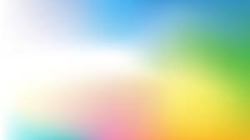
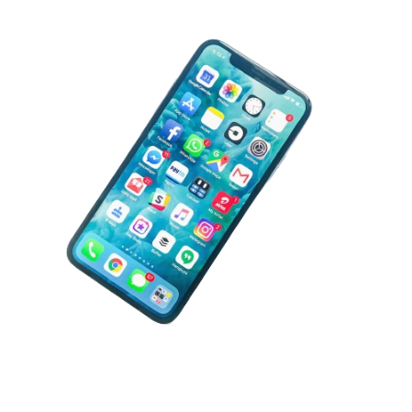
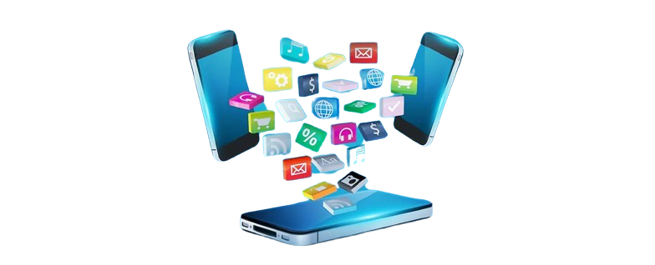
Mobile and Mobile Application
1. What is Mobile
A mobile phone is a wireless handheld device that allows users to make and receive calls.
While the earliest generation of mobile phones could only make and receive calls, today’s
mobile phones do a lot more, accommodating web browsers, games, cameras, video
players and navigational systems.
2. What is Mobile Application
A mobile app (or mobile application) is a software application developed specifically for use
on small, wireless computing devices, such as smartphones and tablets, rather than desktop
or laptop computers. Mobile apps are sometimes categorized according to whether they are
web-based or native apps, which are created specifically for a given platform. A third category,
hybrid apps, combines elements of both native and web apps.

Slide 3
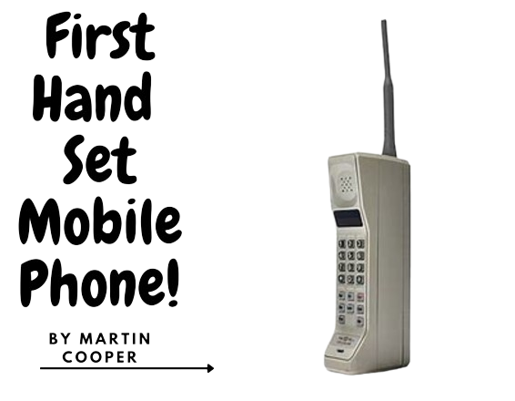
History of Mobile
The Introduce of First Mobile Phone
Mobile phones, particularly the smartphones that have become our inseparable
companions today, are relatively new. The very first mobile phones were not
really mobile phones at all. They were two-way radios that allowed people like
taxi drivers and the emergency services to communicate.
Motorola, on 3 April 1973 were first company to mass produce the first
handheld mobile phone. These early mobile phones are often referred
to as 0G mobile phones, or Zero Generation mobile phones. Most
phones today rely on 3G or 4G mobile technology
Things specifications covered by first Mobile Phone
Model: DynaTAC 8000X
Weight: 1.1 kg
Measure: 23 x 13 x 4.5 cm
Battery Backup: 30 min only
Recharge: 10 hours

Slide 4

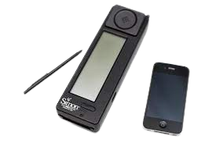
History Mobile Application
1. What is Mobile
Mobile apps were introduced in the 1980s with the release of the first personal digital
assistants (PDAs). However, such apps did not evolve far past the most basic and utilitarian
of functions (e.g., clocks and calculators) until the 21st century, when smartphones
evolved to run larger programs.
As with desktop computers, smartphones are sold with many basic apps preloaded:
an e-mail client, a calendar, a Web browser, a weather forecaster, and so on.
Additional apps are generally downloaded from online distribution platforms
commonly referred to as app stores. The most popular app stores are operated by
smartphone companies, such as Samsung or Huawei, or companies that design their
own operating systems (OS), such as Apple or Google. The Apple app store was
introduced in 2008 and had about 500 apps available, but by 2022 that total had
leapt to over 1.7 million apps. Companies that design their own OS have the
advantage of preinstalling their store’s apps on new devices. Some apps are
free, while others require payment. Any revenue generated by an app—whether
through an upfront transaction, a monthly subscription, microtransactions, or
advertising—is usually shared between an app’s creator and the app store.
Consequently, an app’s cost may vary based on where it is purchased.

Slide 5
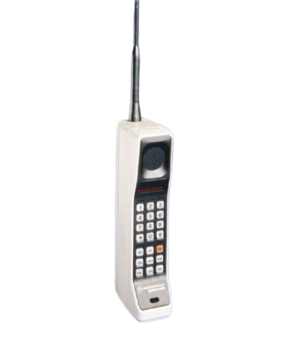
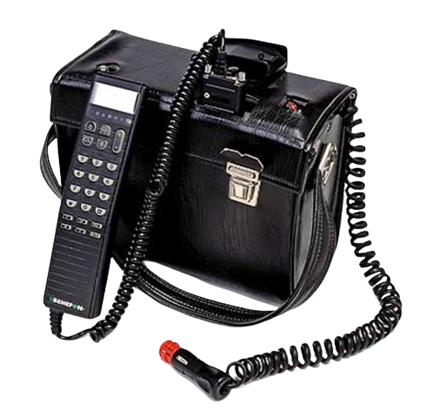
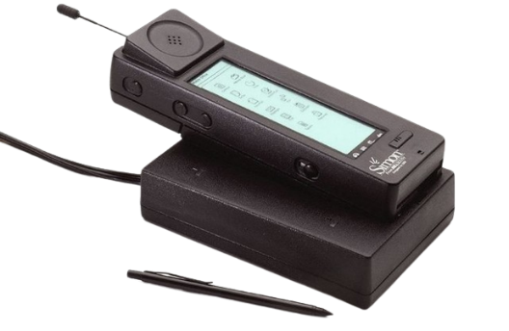
Some 19th Mobile Devices
Devices in 20th century
After working on this topic in conclusion phones have changed throughout the 20th century. They used to be massive
and expensive car phones. They have slowly changed into a small phone that is very useful. They have been used more
often and in the late 1990's they were more affordable and smaller. Here is some 20th century's mobile devices.
Motorola Dynatac 8000x
Launch: 1975
Price: 4000 USD
NOKIA MOBIRA SENATOR
Launch: 1983
Price: 10000 USD
Bellsouth/Ibm SIMON
Launch: 1993
Price: 900 USD

Slide 6
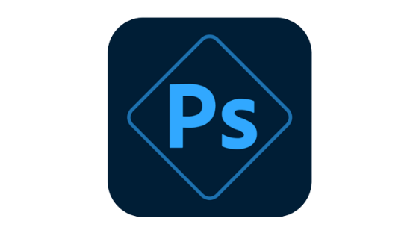
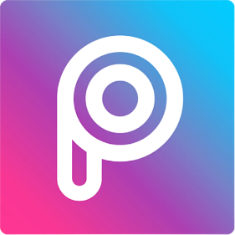

Some Popular Mobile Applications
1. Adobe Photoshop Express
A lightweight version of the popular desktop software, Adobe Photoshop Express allows
you to make basic edits to your photos, such as cropping, resizing, and adjusting color
and exposure.
2. PicsArt
PicsArt is a comprehensive photo editing app that offers a wide range of tools and
features, including filters, effects, stickers, and text overlays. It also has a social
aspect, allowing you to share your edited photos with other users.
2. Facebook
"Facebook" is a social media platform created in 2004 by Mark Zuckerberg and his Harvard College roommates. It allows users to connect with friends, family, and interests, sharing updates, photos, and videos. With over 2.7 billion monthly active users, Facebook is one of the most widely used social media platforms in the world.

Slide 7

THANK YOU SO MUCH
THANKS FOR WATCHING
Thank you for taking the time to watch my presentation. Your attention and interest are greatly appreciated. If you have any questions or feedback, please feel free to share them. I value your input and look forward to any opportunities for further discussion. Once again, thank you for being a part of my presentation audience. ESPACIALLY
THANKS TO UMESH THAPA SIR TO PROVIDE ME THIS HUGE OPPORTUNITY

